Slide 1

Applied Machine Learning (BUAN 6341) Linear Regression/Logistic Regression
Harpreet Singh
Fall 2021
Notes:
Any questions before we start today’s lecture?

Slide 2
Agenda
Linear Regression
Logistic Regression
Advanced Regression

Slide 3
Regression
Given the value of an input X, the output Y belongs to the set of real value R.
Evaluation: predict output accurately
Examples:
Predict housing price
Forecast precipitation

Slide 4
Math (Linear Regression)
Linear relationship: outcome (dependent/criterion) variable is a linear combination of predictor (independent) variables.
$$Y=β_{0}+β_{1}X_{1}+β_{2}X_{2}+…+β_{n}X_{n}+ε$$
Outcome
Intercept
Coefficients
Predictors

Slide 5
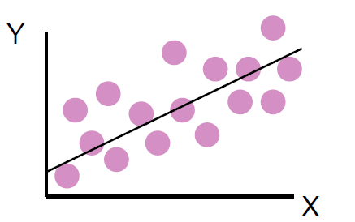
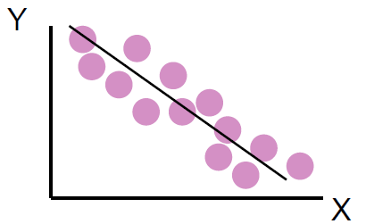
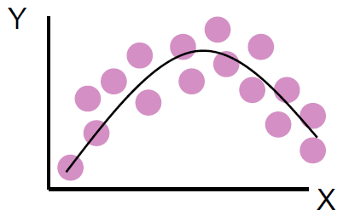
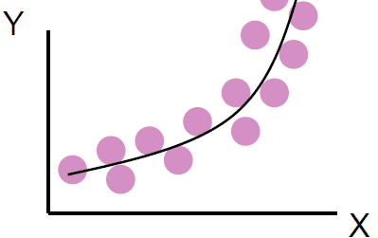

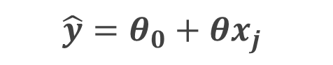
Linear Model?
$$\hat{y}=θ_{0}+θx_{j}$$
$$\hat{y}=θ_{0}+θ_{1}x_{j}+θ_{2}x_{j}^{2}$$
A linear model means linear in parameters (not X)!

Slide 6
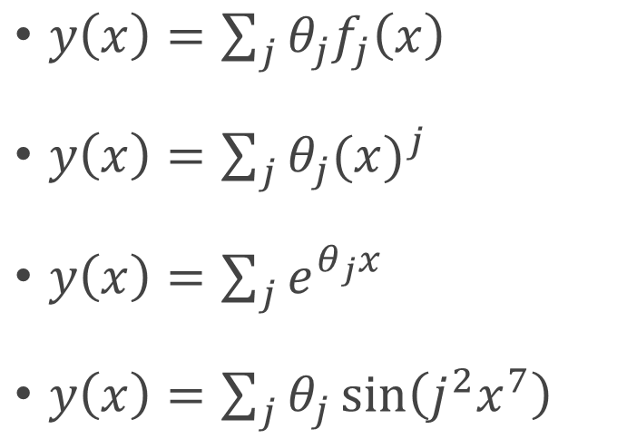
Linear Regression?
$y\left(x\right)=\sum_{j}{{θ_{j}f}_{j}\left(x\right)}$
$y\left(x\right)=\sum_{j}{θ_{j}{(x)}^{j}}$
$y\left(x\right)=\sum_{j}{e^{θ_{j}x}}$
$y\left(x\right)=\sum_{j}{θ_{j}\sin\left(j^{2}x^{7}\right)}$

Slide 7
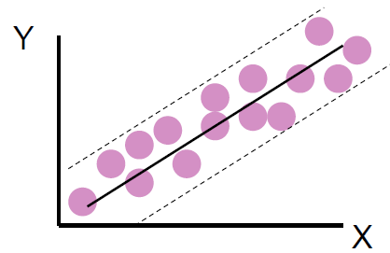
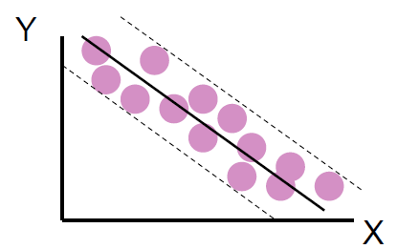
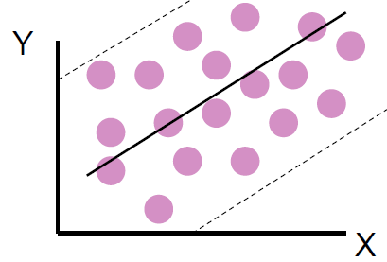
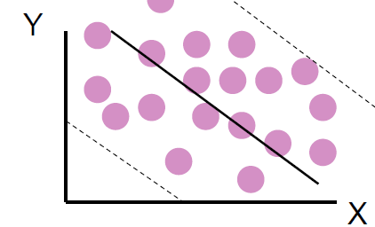
Linear Model?
Strong relationship
Weak relationship
How to evaluation?

Slide 8
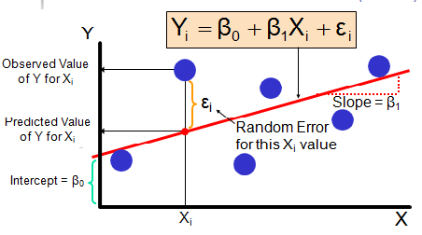
Linear Model Evaluation
Residuals e = observed (y) – predicted (y)

Slide 9
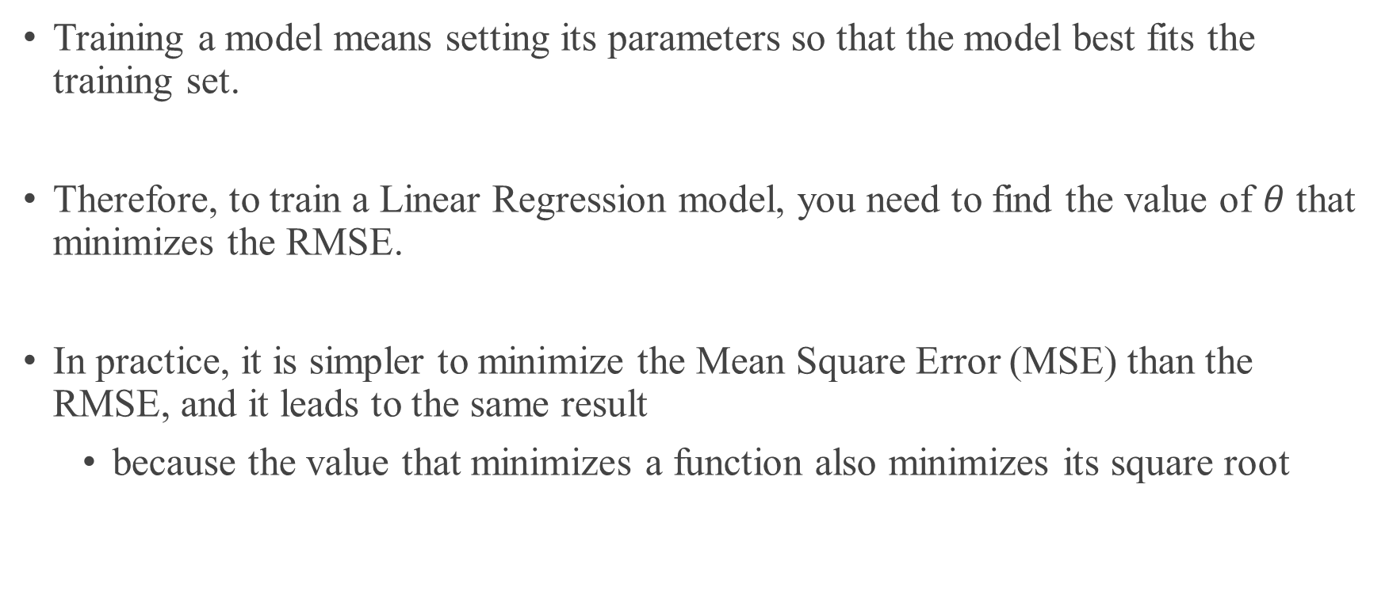
Train a Linear Model
Training a model means setting its parameters so that the model best fits the training set.
Therefore, to train a Linear Regression model, you need to find the value of $θ$ that minimizes the RMSE.
In practice, it is simpler to minimize the Mean Square Error (MSE) than the RMSE, and it leads to the same result
because the value that minimizes a function also minimizes its square root

Slide 10
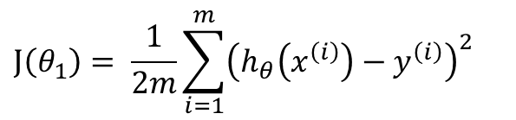
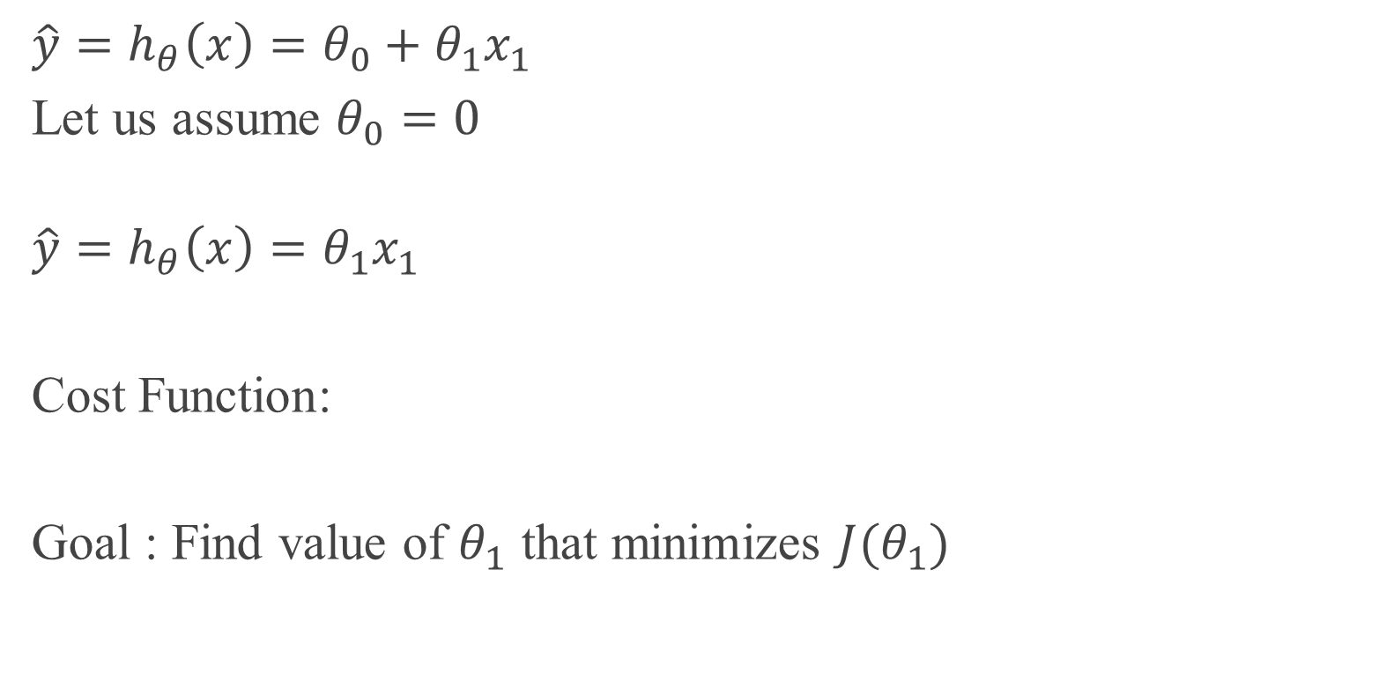
Cost Function
X | Y
1 | 1
2 | 2
3 | 3
$$\hat{y}=h_{θ}\left(x\right)=θ_{0}+θ_{1}x_{1}$$
Let us assume $θ_{0}=0$
$$\hat{y}=h_{θ}\left(x\right)=θ_{1}x_{1}$$
Cost Function:
Goal : Find value of $θ_{1}$ that minimizes $J(θ_{1})$
$$J\left(θ_{1}\right)= \frac{1}{2m}\sum_{i=1}^{m}{{\left(h_{θ}\left(x^{\left(i\right)}\right)−y^{\left(i\right)}\right)}^{2}}$$

Slide 11
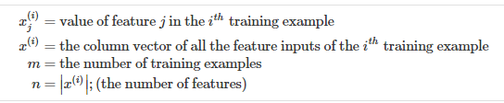
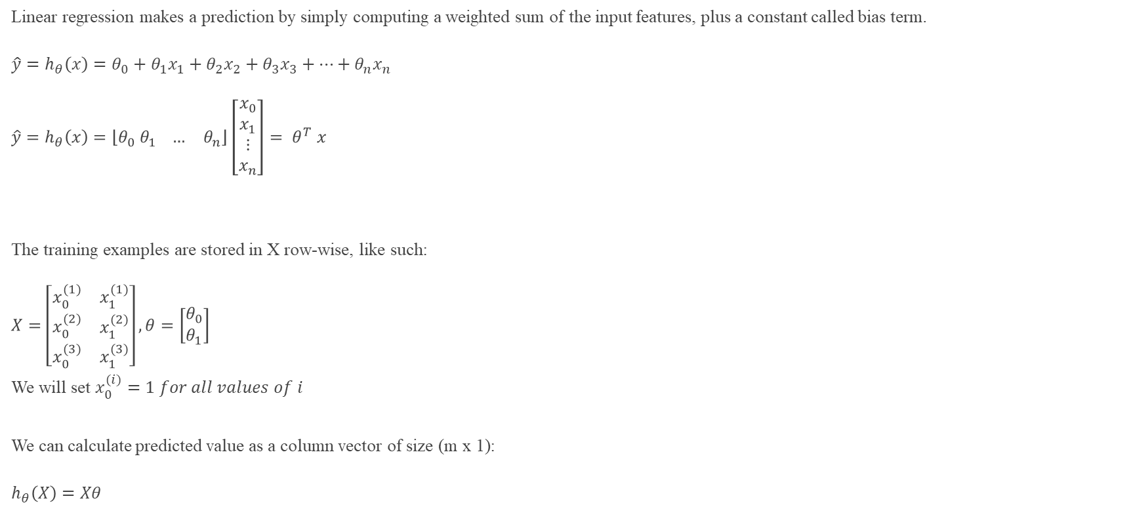
Linear Regression- Matrix Notation
Linear regression makes a prediction by simply computing a weighted sum of the input features, plus a constant called bias term.
$$\hat{y}=h_{θ}\left(x\right)=θ_{0}+θ_{1}x_{1}+θ_{2}x_{2}+θ_{3}x_{3}+…+θ_{n}x_{n}$$
$$\hat{y}=h_{θ}\left(x\right)=\left\lfloor θ_{0} θ_{1} … θ_{n}\right\rfloor \left[\begin{aligned}x_{0} \\ x_{1} \\ ⋮ \\ x_{n}\end{aligned}\right]{= θ}^{T}x$$
The training examples are stored in X row-wise, like such:
$$X=\left[\begin{matrix}x_{0}^{(1)} & x_{1}^{(1)} \\ \begin{aligned}x_{0}^{(2)} \\ x_{0}^{(3)}\end{aligned} & \begin{aligned}x_{1}^{(2)} \\ x_{1}^{(3)}\end{aligned}\end{matrix}\right], θ=\left[\begin{aligned}θ_{0} \\ θ_{1}\end{aligned}\right]$$
We will set $x_{0}^{(i)}=1 for all values of i$
We can calculate predicted value as a column vector of size (m x 1):
$$h_{θ}\left(X\right)=Xθ$$

Slide 12
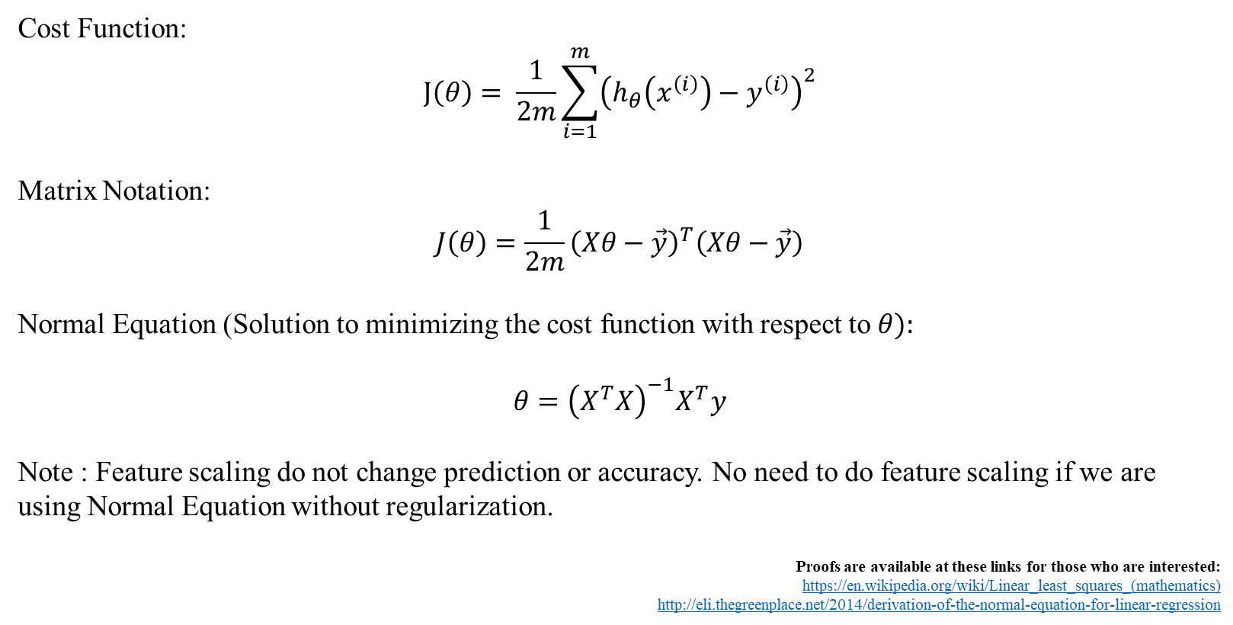
Least Squares Normal Equation
Cost Function:
$$J\left(θ\right)= \frac{1}{2m}\sum_{i=1}^{m}{{\left(h_{θ}\left(x^{\left(i\right)}\right)−y^{\left(i\right)}\right)}^{2}}$$
Matrix Notation:
$$J\left(θ\right)=\frac{1}{2m}{\left(Xθ−\vec{y}\right)}^{T}\left(Xθ−\vec{y}\right)$$
Normal Equation (Solution to minimizing the cost function with respect to $θ):$
$$θ={\left(X^{T}X\right)}^{−1}X^{T}y$$
Note : Feature scaling do not change prediction or accuracy. No need to do feature scaling if we are using Normal Equation without regularization.
Proofs are available at these links for those who are interested:
https://en.wikipedia.org/wiki/Linear_least_squares_(mathematics)
http://eli.thegreenplace.net/2014/derivation-of-the-normal-equation-for-linear-regression
Notes:
Matrix form?

Slide 13
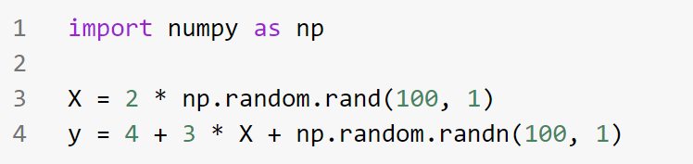
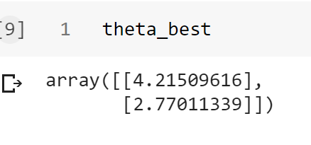
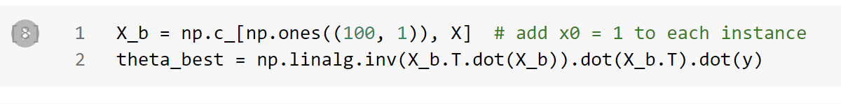
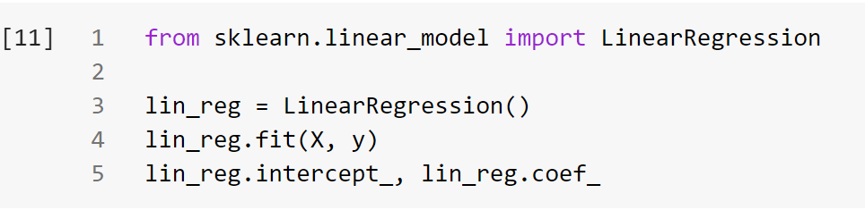

In Python
Numpy
Sklearn

Slide 14
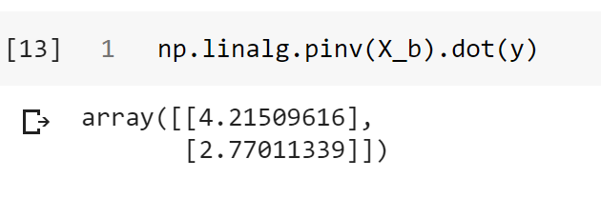
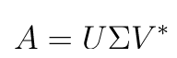
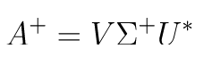
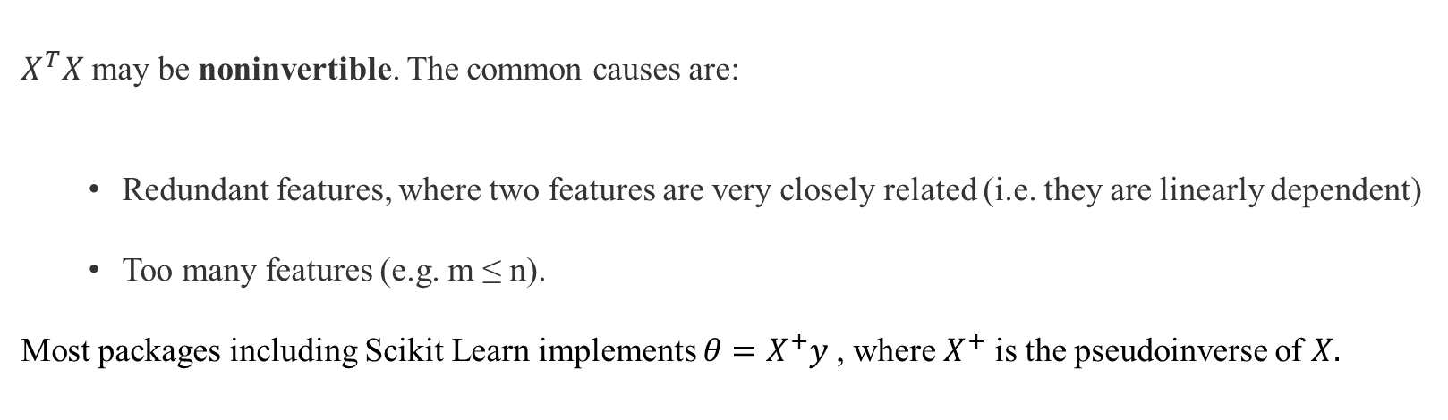
Least Squares Normal Equation
$X^{T}X$ may be noninvertible. The common causes are:
Redundant features, where two features are very closely related (i.e. they are linearly dependent)
Too many features (e.g. m ≤ n).
Most packages including Scikit Learn implements $θ=X^{+}y$, where $X^{+}$ is the pseudoinverse of $X.$
Pseudoinverse – using SVD
Notes:
Matrix form?

Slide 15
Normal Equation Pros and Cons
Cons:
The computational complexity of linear regression is very high
There is no controlling parameters
Pros:
Prediction is very fast

Slide 16
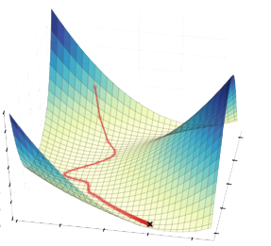
Gradient Descent

Slide 17
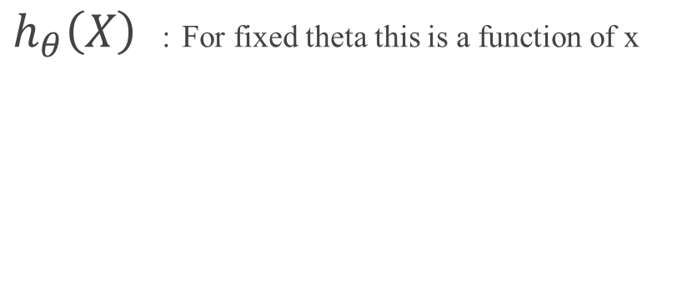
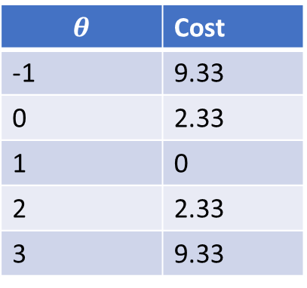
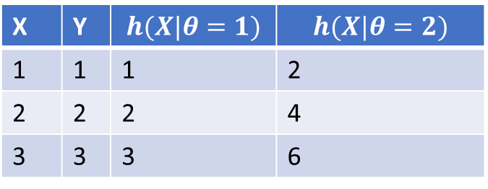
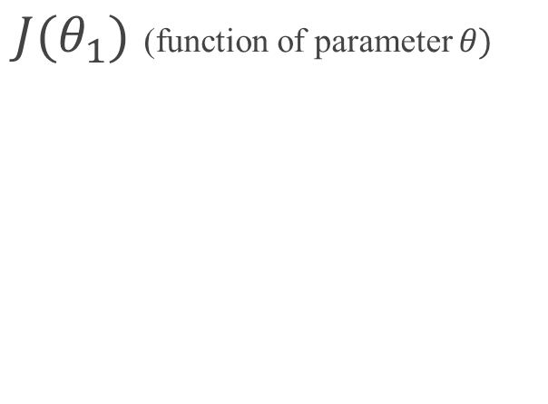
Cost Function
$h_{θ}\left(X\right)$ : For fixed theta this is a function of x
X | Y | $$h(X|θ=1)$$ | $$h(X|θ=2)$$
1 | 1 | 1 | 2
2 | 2 | 2 | 4
3 | 3 | 3 | 6
$J(θ_{1})$ (function of parameter $θ)$
$$θ$$ | Cost
-1 | 9.33
0 | 2.33
1 | 0
2 | 2.33
3 | 9.33
Convex Function

Slide 18
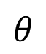
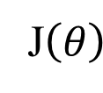
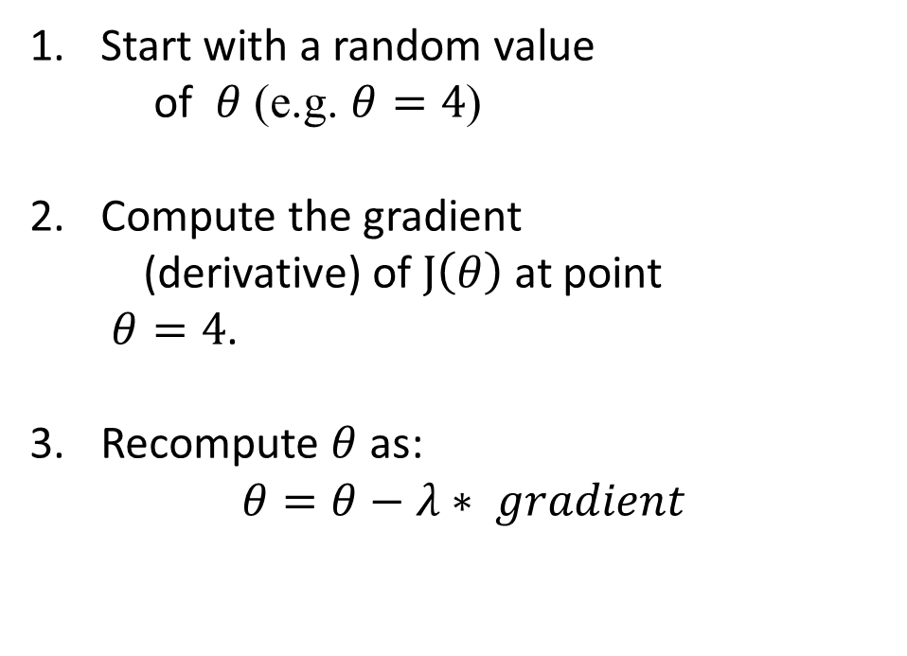
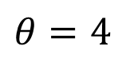
Gradient Descent (GD) (idea)
Start with a random value of $θ$(e.g. $θ=4$)
Compute the gradient (derivative) of $J\left(θ\right)$at point $θ=4$.
Recompute $θ$ as:
$$θ=θ−λ∗ gradient$$
J$\left(θ\right)$
$$θ=4$$
$$θ$$

Slide 19
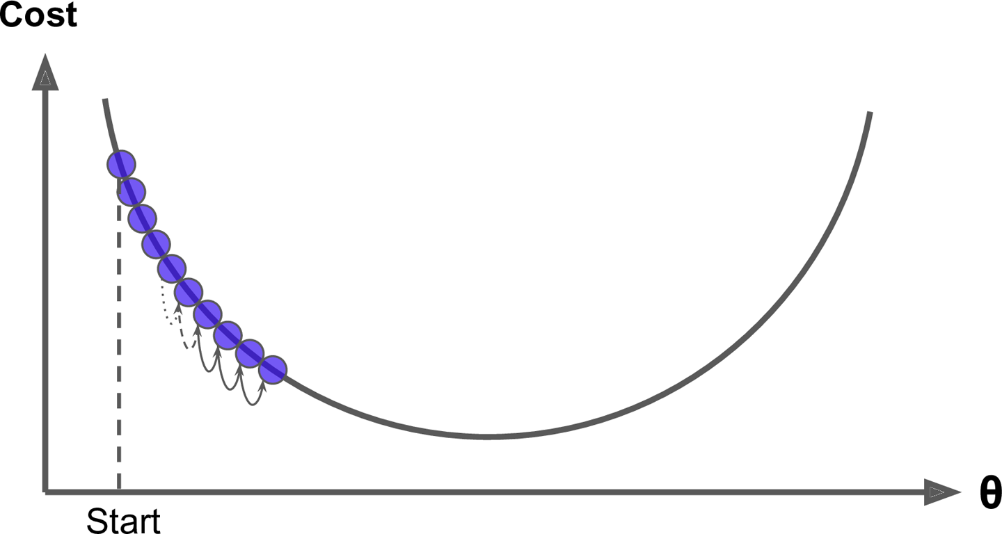
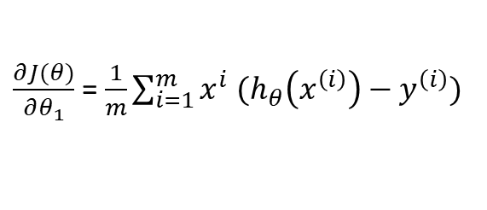
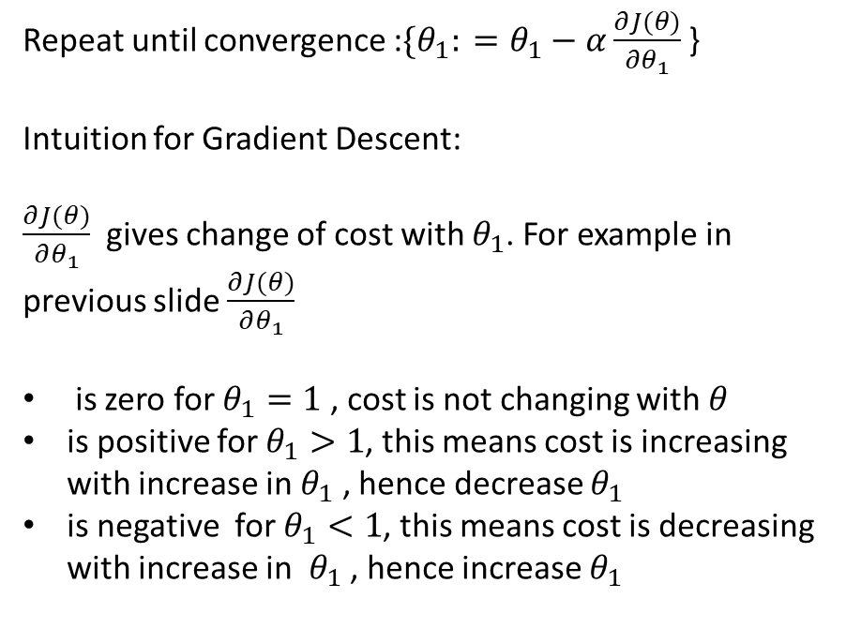
Gradient Descent
Repeat until convergence :${\{θ}_{1}: =θ_{1}−α\frac{∂J(θ)}{∂θ_{1}}$ }
Intuition for Gradient Descent:
$\frac{∂J(θ)}{∂θ_{1}}$ gives change of cost with $θ_{1}$. For example in previous slide $\frac{∂J(θ)}{∂θ_{1}}$
is zero for $θ_{1}=1$ , cost is not changing with $θ$
is positive for $θ_{1}>1$, this means cost is increasing with increase in $θ_{1}$ , hence decrease $θ_{1}$
is negative for $θ_{1}<1$, this means cost is decreasing with increase in $θ_{1}$ , hence increase $θ_{1}$
$\frac{∂J(θ)}{∂θ_{1}}$ = $\frac{1}{m}\sum_{i=1}^{m}{{x^{i} (h}_{θ}\left(x^{\left(i\right)}\right)−y^{\left(i\right)})}$

Slide 20
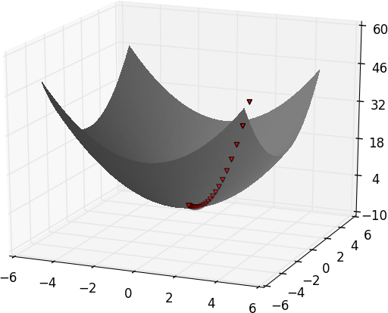
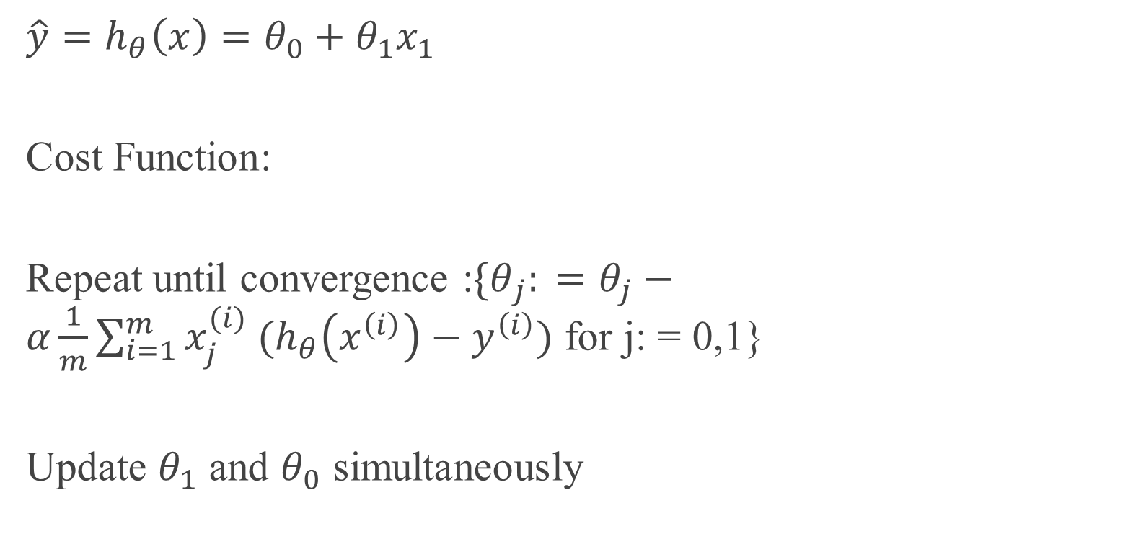
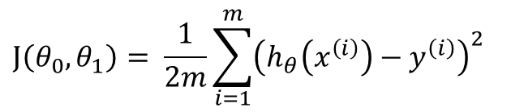
Gradient Descent- Two Parameters
Convex Function
$$\hat{y}=h_{θ}\left(x\right)=θ_{0}+θ_{1}x_{1}$$
Cost Function:
Repeat until convergence :${\{θ}_{j}: =θ_{j}−α\frac{1}{m}\sum_{i=1}^{m}{{x_{j}^{(i)} (h}_{θ}\left(x^{\left(i\right)}\right)−y^{\left(i\right)})}$ for j: = 0,1}
Update $θ_{1}$ and $θ_{0}$ simultaneously
$$J\left(θ_{0},θ_{1}\right)= \frac{1}{2m}\sum_{i=1}^{m}{{\left(h_{θ}\left(x^{\left(i\right)}\right)−y^{\left(i\right)}\right)}^{2}}$$
Image Source : Book: Data Science from scratch, 2nd edition.

Slide 21
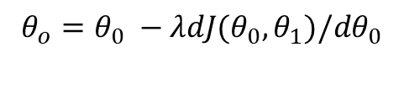
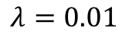
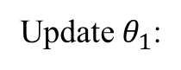
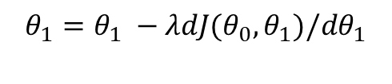
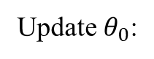
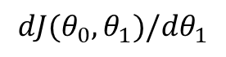
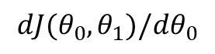
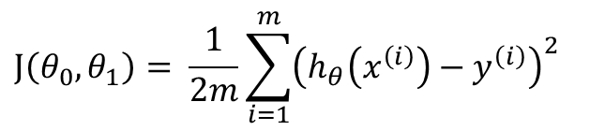
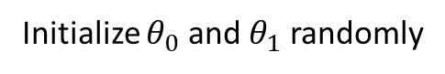
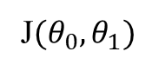
Gradient Descent- Two Parameters
$$λ=0.01$$
$$J\left(θ_{0},θ_{1}\right)= \frac{1}{2m}\sum_{i=1}^{m}{{\left(h_{θ}\left(x^{\left(i\right)}\right)−y^{\left(i\right)}\right)}^{2}}$$
Initialize $θ_{0}$ and $θ_{1}$ randomly
for e = 0, num_epochs do
Compute:
$$dJ(θ_{0},θ_{1})/dθ_{0}$$
and
$$dJ(θ_{0},θ_{1})/dθ_{1}$$
Update $θ_{0}$:
$$θ_{o}=θ_{0} −λdJ(θ_{0},θ_{1})/dθ_{0}$$
Update $θ_{1}$:
$$θ_{1}=θ_{1} −λdJ(θ_{0},θ_{1})/dθ_{1}$$
Print:
J$(θ_{0},θ_{1})$
// Useful to see if this is becoming smaller or not.
end

Slide 22


Matrix Notation
General: Repeat until convergence :${\{θ}_{j}: =θ_{j}−α\frac{∂J(θ)}{∂θ_{j}}$ for j: = 0….n}
Linear Regression: Repeat until convergence :${\{θ}_{j}: =θ_{j}−α\frac{1}{m}\sum_{i=1}^{m}{{x_{j}^{(i)} (h}_{θ}\left(x^{\left(i\right)}\right)−y^{\left(i\right)})}$ for $j ∈\left\{0,1,2…n\right\}$}
Matrix Notation:
Generic :
$$θ≔θ−α∇J\left(θ\right)$$
Where $∇J\left(θ\right)$ is a column vector of form:$∇J\left(θ\right)= \left\lceil \begin{aligned}\frac{∂J\left(θ\right)}{∂θ_{0}} \\ \frac{∂J\left(θ\right)}{∂θ_{1}} \\ . \\ . \\ . \\ \frac{∂J\left(θ\right)}{∂θ_{n}}\end{aligned}\right\rceil$
Linear Regression: $θ ≔θ −\frac{α}{m}X^{T}(Xθ−\vec{y}$)

Slide 23

Learning Rate

Slide 24




Effect of learning rate - code

Slide 25

Pros and Cons
Advantages:
Simple and often quite effective on ML tasks
Often very scalable
Drawbacks
Might find a local minimum
Only applies to smooth function (differentiable)
Fortunately, the MSE cost function for a Linear Regression model happens to be a convex function, which means that if you pick any two points on the curve, the line segment joining them never crosses the curve.

Slide 26

Feature Scale
The cost function has the shape of a bowl, but it can be an elongated bowl if the features have very different scales.
Figure shows Gradient Descent on a training set where features 1 and 2 have the same scale (on the left), and on a training set where feature 1 has much smaller values than feature 2 (on the right)
Image source : Book - Hands-On Machine Learning with Scikit-Learn and TensorFlow: Concepts, Tools, and Techniques to Build Intelligent Systems

Slide 27

Gradient Descent- Two Parameters
expensive
$$λ=0.01$$
$$J\left(θ_{0},θ_{1}\right)= \frac{1}{2m}\sum_{i=1}^{m}{{\left(h_{θ}\left(x^{\left(i\right)}\right)−y^{\left(i\right)}\right)}^{2}}$$
Initialize $θ_{0}$ and $θ_{1}$ randomly
for e = 0, num_epochs do
Compute:
$$dJ(θ_{0},θ_{1})/dθ_{0}$$
and
$$dJ(θ_{0},θ_{1})/dθ_{1}$$
Update $θ_{0}$:
$$θ_{o}=θ_{0} −λdJ(θ_{0},θ_{1})/dθ_{0}$$
Update $θ_{1}$:
$$θ_{1}=θ_{1} −λdJ(θ_{0},θ_{1})/dθ_{1}$$
Print:
$$J(θ_{0},θ_{1})$$
end

Slide 28








Gradient Descent- Mini Batch
$$λ=0.01$$
Initialize $θ_{0}$ and $θ_{1}$ randomly
$$j\left(θ_{0},θ_{1}\right)= \frac{1}{2m}\sum_{iεB}{{\left(h_{θ}\left(x^{\left(i\right)}\right)−y^{\left(i\right)}\right)}^{2}}$$
for e = 0, num_epochs do
for b = 0, num_batches do
Compute:
$$dj(θ_{0},θ_{1})/dθ_{0}$$
and
$$dj(θ_{0},θ_{1})/dθ_{1}$$
Update $θ_{0}$:
$$θ_{o}=θ_{0} −λdj(θ_{0},θ_{1})/dθ_{0}$$
Update $θ_{1}$:
$$θ_{1}=θ_{1} −λdj(θ_{0},θ_{1})/dθ_{1}$$
Print:
j$(θ_{0},θ_{1})$
// Useful to see if this is becoming smaller or not.
end

Slide 29


Gradient Descent Variations
Batch Gradient Descent : Uses whole batch of training data at every iteration
Stochastic Gradient Descent: Each step uses a random instance in the training set
Mini Batch Gradient Descent : Each step uses a subset of instance in the training set
Batch Gradient Stochastic Gradient

Slide 30


Variations
Stochastic gradient descent
Mini batch gradient descent

Slide 31
Summary
Algorithm | Large m | Large n | Hyperparameter | Scaling required | sklearn
Normal Equation | Fast | Slow | 0 | No | n/a
SVD | Fast | Slow | 0 | No | LinearRegression
Batch GD | Slow | Fast | 2 | Yes | n/a
Stochastic GD | Fast | Fast | ≥2 | Yes | SGDRegressor
Mini-batch GD | Fast | Fast | ≥2 | Yes | n/a

Slide 32
Other Regressions

Slide 33



Polynomial Regression
Generate new features consisting of all polynomial combinations of the original features
A linear model
An application of non-linear transformations
$$X=\left(x_{0}, x_{1}\right) −→X^{′}=\left(x_{0},x_{1},x_{0}x_{1},x_{0}^{2},x_{1}^{2}\right)$$
$$Y=w_{0}x_{0}+w_{1}x_{1}+w_{01}x_{0}x_{1}+w_{00}x_{0}^{2}+w_{11}x_{1}^{2}$$

Slide 34


Example I: Polynomial Features

Slide 35


Example I: Polynomial Features

Slide 36

Example I: Polynomial Features

Slide 37
Generalization, Overfitting, and Underfitting
Generalization ability refers to an algorithm's ability to give accurate predictions for new, previously unseen data.
Assumptions:
Future unseen data (test set) will have the same properties as the current training sets.
Thus, models that are accurate on the training set are expected to be accurate on the test set.
But that may not happen if the trained model is tuned too specifically to the training set.
Models that are too complex for the amount of training data available are said to overfit and are not likely to generalize well to new examples.
Models that are too simple, that don't even do well on the training data, are said to underfit and also not likely to generalize well.

Slide 38

Generalization
Overfitting
Low test score
Complex models
Under fitting
Low test and train score

Slide 39

Learning Curves
How test and training error changes with size of data set?

Slide 40


Learning Curves

Slide 41


Learning Curves

Slide 42
Regularization
Goal: optimize some combination of fit and simplicity
Penalize the magnitude of coefficients of features
Minimize the error between predicted and actual examples
Early stopping (for gradient descent):
Ridge Regression:
L2-norm: adds penalty equivalent to square of the magnitude of coefficients
Lasso Regression:
L1-norm: adds penalty equivalent to absolute value of the magnitude of coefficients

Slide 43


Regularization- Early Stopping

Slide 44
Regularization- Early Stopping

Slide 45

Regularization- Early Stopping

Slide 46

Regularization- Early Stopping

Slide 47
Large coefficient
What does a large coefficient signify?
It means that we’re putting a lot of emphasis on that feature, i.e. the particular feature is a good predictor for the outcome.
When it becomes too large, the algorithm starts modelling intricate relations to estimate the output and ends up overfitting to the particular training data.

Slide 48

Ridge Regression
A regularization term will be added to the cost function
$$J\left(θ\right)=MSE\left(θ\right)+\frac{λ}{2}\sum_{i=1}^{n}{θ_{i}^{2}}$$
$J\left(θ\right)=\frac{1}{2m}{\left(Xθ−\vec{y}\right)}^{T}\left(Xθ−\vec{y}\right)+\frac{λ}{2}{\left(θ⊙l\right)}^{T}\left(θ⊙l\right), l=\left[\begin{aligned}0 \\ 1 \\ 1 \\ ⋮ \\ 1\end{aligned}\right]$ and $⊙$ is hadamard product (elementwise multiplication)
The tuning parameter $λ$serves to control the relative impact of these two terms on the regression coefficient estimate.
Selecting a good value for $λ$is critical.

Slide 49


Hyper parameter : $λ$
$λ=0$:
The objective becomes same as simple linear regression.
We’ll get the same coefficients as simple linear regression.
$λ=∞$:
The coefficients will be zero. Why? Because of infinite weightage on square of coefficients, anything less than zero will make the objective infinite.
$$<0<λ<∞$$
The magnitude of α will decide the weightage given to different parts of objective.
The coefficients will be somewhere between 0 and ones for simple linear regression.

Slide 50

Ridge Regression

Slide 51



Solutions Ridge
Normal Equation:
$$θ={\left(X^{T}X+λL\right)}^{−1}X^{T}y,$$
$$L=\left|\begin{matrix}0 & & \\ & 1 & \\ & & \begin{matrix}. & & \\ & . & \\ & & 1\end{matrix}\end{matrix}\right|$$
L is a matrix with 0 at the top left and 1's down the diagonal, with 0's everywhere else. It has same dimensions as $X^{T}X$. If $m(observations≤n$(features), then $X^{T}X$ is not invertible but $X^{T}X+λ.L$ is invertible
Gradient Descent:
Repeat until convergence :$\left\{\begin{aligned}θ_{0}: =θ_{0}−\frac{α}{m}\sum_{i=1}^{m}{{x_{j}^{(i)} (h}_{θ}\left(x^{\left(i\right)}\right)−y^{\left(i\right)})} \\ θ_{j}: =θ_{j}−α\left[\left(\frac{1}{m}\sum_{i=1}^{m}{{x_{j}^{(i)} (h}_{θ}\left(x^{\left(i\right)}\right)−y^{\left(i\right)})}\right)+\frac{λ}{m}θ_{j}\right] for j ∈\left\{1,2…n\right\}\end{aligned}\right\}$
Matrix Notation:
$θ ≔θ −\frac{α}{m}\left[X^{T}(Xθ−\vec{y}\text{) }+λ\left(θ⊙l\right)\right]$, $l=\left[\begin{aligned}0 \\ 1 \\ 1 \\ ⋮ \\ 1\end{aligned}\right]$ and $⊙$ is hadamard product (elementwise multiplication).

Slide 52



Ridge - Sklearn
Here alpha is same as lambda in previous slides
You can specify alpha and learning rate as hyperparameters as well

Slide 53

Ridge – effect on co-efficients

Slide 54


Ridge - Sklearn

Slide 55

Ridge - Sklearn

Slide 56

Ridge – Learning Curves

Slide 57

Lasso
Least Absolute Shrinkage and Selection Operator Regression
$$J\left(θ\right)=MSE\left(θ\right)+λ\sum_{i=1}^{n}{|θ_{i}|}$$
Lasso combines some of the shrinking advantages of ridge with variable selection
The L1 penalty has the effects of forcing some coefficient estimates to be exactly equal to zero
Tip: Techniques such as cross validation are recommended to determine which approach is better on a particular dataset

Slide 58

Solutions Lasso
No Closed firm solution
Scikit Learn uses Coordinate Descent Algorithm (beyond scope of this course)
Gradient Descent (approximate solution using sub-gradient):
$$θ ≔θ −α\left[{\frac{1}{m}X}^{T}(Xθ−\vec{y}\text{) }+λ sign(θ)\right]$$
$$sign\left(θ\right)=\left[\begin{aligned}0 \\ sign(θ_{1}) \\ sign(θ_{2}) \\ ⋮ \\ sign(θ_{n})\end{aligned}\right]$$
$$where sign\left(θ_{j}\right)=\left\{\begin{aligned}−1 if θ_{j}<0 \\ 0 if θ_{j}=0 \\ + 1 if θ_{j}>1 \end{aligned}\right.$$

Slide 59


Lasso-sklearn
You can specify alpha and learning rate as hyperparameters as well

Slide 60

L1 vs L2

Slide 61

L1 vs L2

Slide 62
Key Difference
Ridge: It includes all (or none) of the features in the model. Thus, the major advantage of ridge regression is coefficient shrinkage and reducing model complexity.
Lasso: Along with shrinking coefficients, lasso performs feature selection as well. As we observed earlier, some of the coefficients become exactly zero, which is equivalent to the particular feature being excluded from the model.

Slide 63
Typical Use Cases
Ridge: It is majorly used to prevent overfitting. Since it includes all the features, it is not very useful in case of exorbitantly high number features, say in millions, as it will pose computational challenges.
Lasso: Since it provides sparse solutions, it is generally the model of choice (or some variant of this concept) for modelling cases where the number features are in millions or more. In such a case, getting a sparse solution is of great computational advantage as the features with zero coefficients can simply be ignored.

Slide 64
Presence of Highly Correlated Features
Ridge: It generally works well even in presence of highly correlated features as it will include all of them in the model but the coefficients will be distributed among them depending on the correlation.
Lasso: It arbitrarily selects any one feature among the highly correlated ones and reduced the coefficients of the rest to zero. Also, the chosen variable changes randomly with change in model parameters. This generally doesn’t work that well as compared to ridge regression.

Slide 65



ElasticNet
We can add both L1 and L2 terms to the cost function as well :
$$J\left(θ\right)=MSE\left(θ\right)+rλ\sum_{i=1}^{n}{\left|θ_{i}\right|+\frac{\left(1−r\right)λ}{2}\sum_{i=1}^{n}{θ^{2}}}$$

Slide 66
Linear Models - Classification

Slide 67


Linear Models for Classification

Slide 68
Linear Models for Classifications
The way in which they measure how well a particular combination of coefficients and intercept fits the training data
If and what kind of regularization they use

Slide 69
Linear Models - Classification
Logistic Regression

Slide 70
General View
Logistic regression is a classification algorithm
It predicts the probability of occurrence of an event by fitting data to a logit function
Outcome: categorial variables

Slide 71

Math (Logistic Regression)
$p$: probability of belong to class “1”
Need to relate $p$ to predictors with a function that guarantees $0≤p≤1$
Standard linear function does not
Fix: logistic response function (logit)
$t=$ ${θ^{T}x=θ}_{0}+θ_{1}x_{1}+…+θ_{n}x_{n}$
$h_{θ}\left(x\right)= \hat{p}=σ(t)=\frac{e^{t}}{1+e^{t}}=\frac{1}{1+e^{−t}}$

Slide 72



Logit Function
Logit function is a sigmoid function that returns the result between 0 and 1.
Prediction:
$$\hat{y}=\left\{\begin{aligned}0 if \hat{ p}<0.5 \\ 1 if \hat{ p}≥0.5 \end{aligned}\right.$$
$$\hat{p}<0.5 , when t<0$$
$$\hat{p}≥0.5 when t≥0$$
This means Logistic Regression predicts 1 if $θ^{T}x$ is positive and 0 if it is negative

Slide 73


Training and Cost function
Cost function single training instance :
$$c\left(θ\right)=\left\{\begin{aligned}−\log\left(\hat{ p}\right) if y=1 \\ −\log\left(1−\hat{p}\right) if y=0.5 \end{aligned}\right.$$
Alternatively:
$$c\left(θ\right)=−y\log\left(\hat{p}\right)−\left(1−y\right)\log\left(1−\hat{p}\right)$$
The cost function over the whole triaging set:
$$J\left(θ\right)=−\frac{1}{m}\sum_{i=1}^{m}{\left[y^{i}\log\left({\hat{p}}^{(i)}\right)+(1−y^{(i)})\log\left(1−{\hat{p}}^{(i)}\right)\right]}$$
Vector format :
$$h=σ\left(Xθ\right)$$
$$J\left(θ\right)=\frac{1}{m}\left(−y^{T} log(h)−{\left(1−y\right)}^{T}log⁡(1−h) \right)$$
Intuition
$c\left(θ\right)=0 , if \hat{p}=y$,
$c\left(θ\right)→∞,$ if $y=1 and \hat{p}→0$
$c\left(θ\right)→∞,$ if $y=0 and \hat{p}→1$

Slide 74


Gradient Descent Logistic Regression
Repeat until convergence :${\{θ}_{j}: =θ_{j}−α\frac{1}{m}\sum_{i=1}^{m}{x_{j}^{\left(i\right)}({\hat{p}}^{(i)}−y^{\left(i\right)})}$ for j: = 0…n}, where ${\hat{p}}^{(i)}= σ\left(θ^{T}x^{\left(i\right)}\right)$
Vector format :
$$θ≔θ−\frac{α}{m}X^{T}(σ\left(Xθ\right)−\vec{y})$$

Slide 75


Logistic Regression- Regularization
We can use both L1 and L2 regularization for logistic regression

Slide 76

Logistic Regression- Regularization

Slide 77

Decision Boundary

Slide 78

Softmax Regression
Generalization of Logistic regression
$s_{k}\left(x\right)={{(θ}^{k})}^{T}.x$, each class has parameter vector $θ^{k}$
$${\hat{p}}_{k}=\frac{e^{s_{k}\left(x\right)}}{\sum_{j=1}^{k}{e^{s_{j}(x)}}}$$
$\hat{y}=\underset{k}{argmax} s_{k}(x)$

Slide 79

Softmax Regression

Slide 80

Cost function
Softmax regression classifier predicts only one class at a time
Objective:
Estimate the high probability for the target class
$$J\left(Θ\right)=−\frac{1}{m}\sum_{i=1}^{m}{\sum_{k=1}^{K}{y_{k}^{\left(i\right)}\log\left({\hat{p}}_{k}^{\left(i\right)}\right)}}$$
where $Θ$ is a parameter matrix

Slide 81

Cost Function

Slide 82

Gradient vector for class k
$$∇_{θ^{\left(k\right)}}J\left(Θ\right)=\frac{1}{m}\sum_{i=1}^{m}{ \left({\hat{p}}_{k}^{(i)}−y_{k}^{(i)}\right)x^{(i)}}$$

Slide 83

Multiclass Classification: One-vs-all
If there are $K$classes in output, fit $K$binary logistic regressions --
Choose one class and then lump all the others into a single second class. Do this repeatedly, applying binary logistic regression to each case. For each observation, the class with the highest predicted probability is the prediction for that observation.

Slide 84
Acknowledgement
Python Code for this presentation is available om eLearning – code_presentation.ipynb
code_presentation.ipynb- The source code for this file is adapted from git hub repository of chapter 4 of the book
Hands-on Machine Learning with Scikit-Learn, Keras and TensorFlow
Git hub of book - https://github.com/ageron/handson-ml2

